Slide 1

Object Edge Detection using Tkinter-python
Tuesday, 2019/04/09
Haryanto

Slide 2



Outline
Library
Tkinter
PIL
CV2
NumPy
Result
Demo

Slide 3

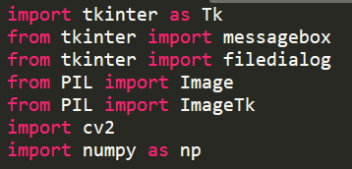
Library use in this CODE

Slide 4
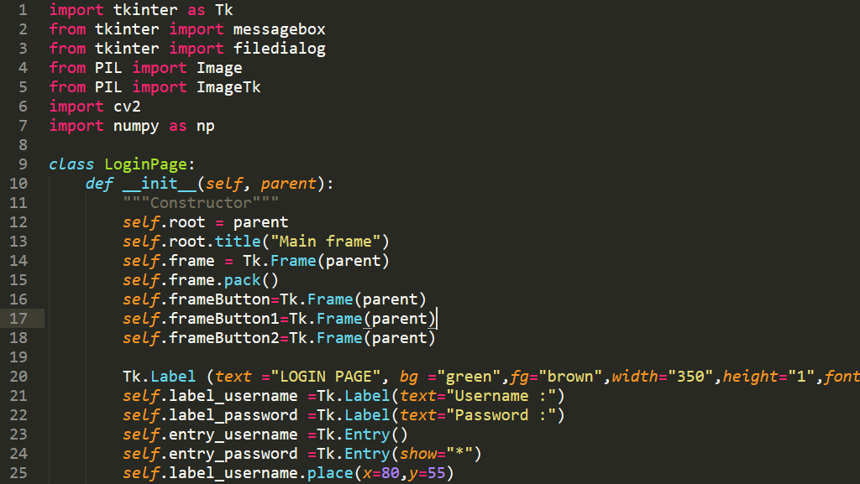
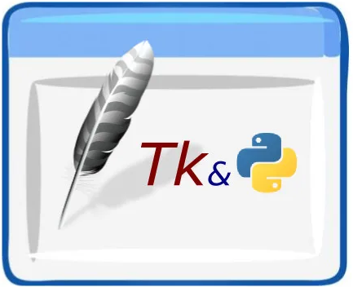
Tkinter
Tkinter is the standard GUI library for Python. Python when combined with Tkinter provides a fast and easy way to create GUI applications. Tkinter provides a powerful object-oriented interface to the Tk GUI toolkit.
Creating a GUI application using Tkinter is an easy task. All you need to do is following steps :
Import the Tkinter module.
Create the GUI application main window.
Add one or more of the above-mentioned widgets to the GUI application.
Enter the main event loop to take action against each event triggered by the user.
fhttps://www.tutorialspoint.com/python3/python_gui_programming.htm

Slide 5

Tkinter
Tkinter Widgets
Tkinter provides various controls, such as buttons, labels and text boxes used in a GUI application. These controls are commonly called widgets.
Button
Canvas
Checkbutton
Entry
Frame
Label
Listbox
Geometry Management
Tkinter widgets have access to the specific geometry management methods, such as :
The pack() Method
The grid() Method
The place() Method
Menubutton
Menu
Message
Radiobutton
Scale
Scrollbar
Text
Toplevel
Spinbox
PanedWindow
LabelFrame
tkMessageBox

Slide 6
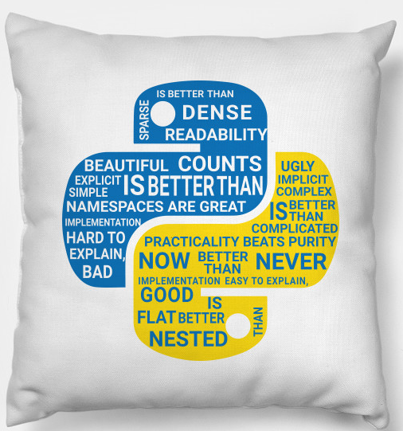
PIL (Python Imaging Library)
This library provides extensive file format support, an efficient internal representation, and fairly powerful image processing capabilities.
The core image library is designed for fast access to data stored in a few basic pixel formats. It should provide a solid foundation for a general image processing tool. a few possible uses of this library is:
Image Archives
Image Display
Image Processing
https://pillow.readthedocs.io/en/stable/handbook/overview.html

Slide 7

CV2 (Open Source Computer Vision Library)
OpenCV-Python is a library of Python bindings designed to solve computer vision problems. All the OpenCV array structures are converted to and from Numpy arrays. This also makes it easier to integrate with other libraries that use Numpy such as SciPy and Matplotlib.
This is the possible using open cv :
Read an image
Display an image
Write an image
https://docs.opencv.org/3.4/d0/de3/tutorial_py_intro.html

Slide 8
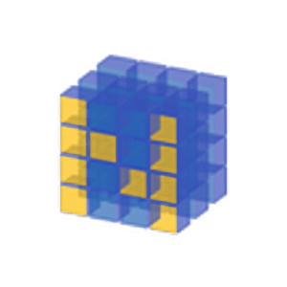
NumPy
NumPy is the fundamental package for scientific computing with Python. It contains among other things:
a powerful N-dimensional array object
sophisticated (broadcasting) functions
tools for integrating C/C++ and Fortran code
useful linear algebra, Fourier transform, and random number capabilities
Besides its obvious scientific uses, NumPy can also be used as an efficient multi-dimensional container of generic data. Arbitrary data-types can be defined. This allows NumPy to seamlessly and speedily integrate with a wide variety of databases.
http://www.numpy.org/

Slide 9


Result
The result from our application we made is :
Login page
get permission to use the application if the username and password are correct. if not the application will bring up a message error.
Main Page
This is the second window, we use Toplevel to create this window
File dialog to access path file
Exception file wrong format
Show image in canvas
Edge detection using openCV

Slide 10
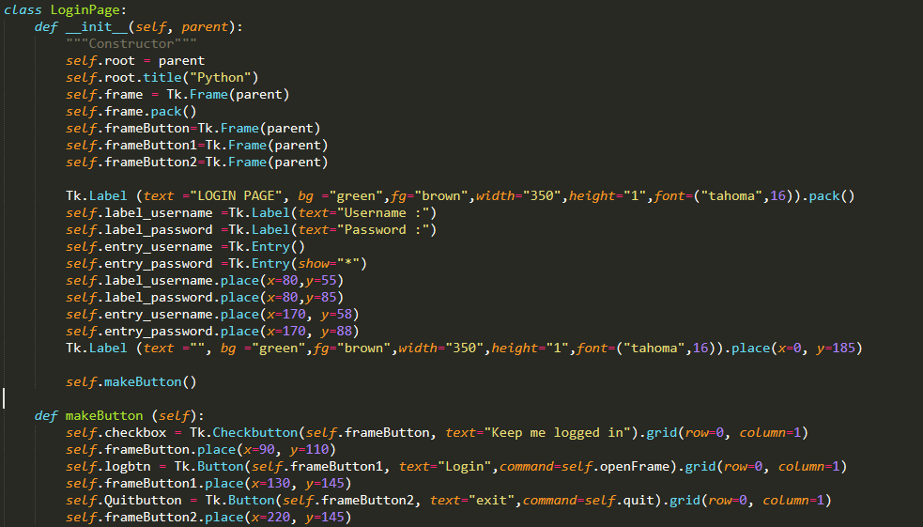
Login Page Class
Constructor
Call Method when running Apps
Method to build button

Slide 11
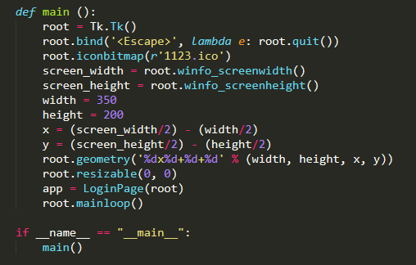
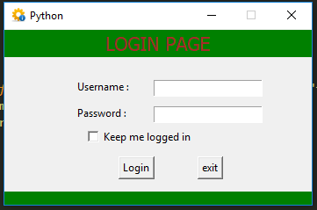
Login Page Class
Structure Geometry

Slide 12
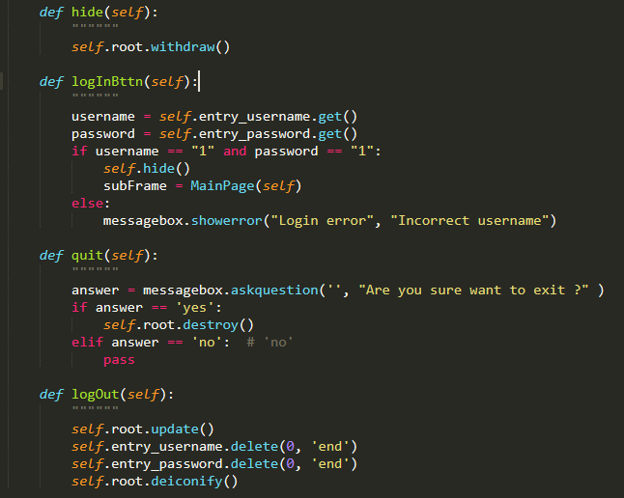
Login Page Class
Statement Condition in Login Button
Statement Condition in Exit Button

Slide 13
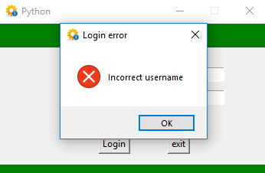
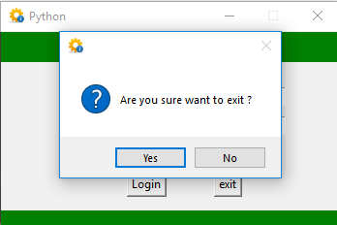
Login Page Class
When we input wrong variable it will be like this
Message box when we push the exit button

Slide 14
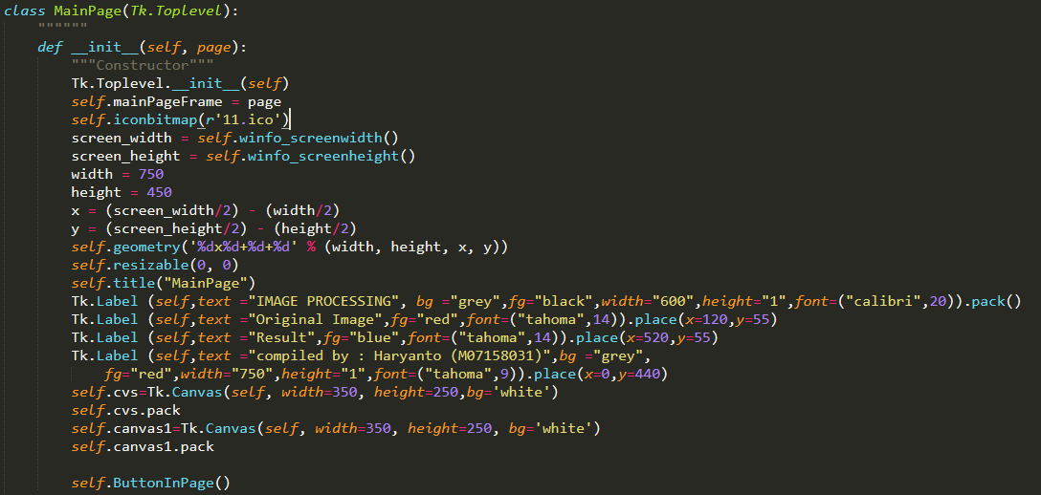
Code From Main Page Class
Get constructor from login page
Specific Geometry of the main page window

Slide 15
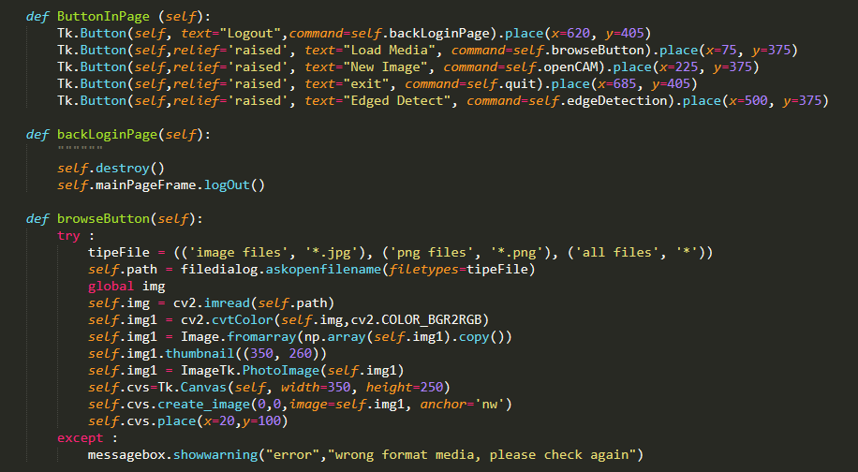
Code From Main Page Class
Call the login page method
Global Variable
Exception

Slide 16
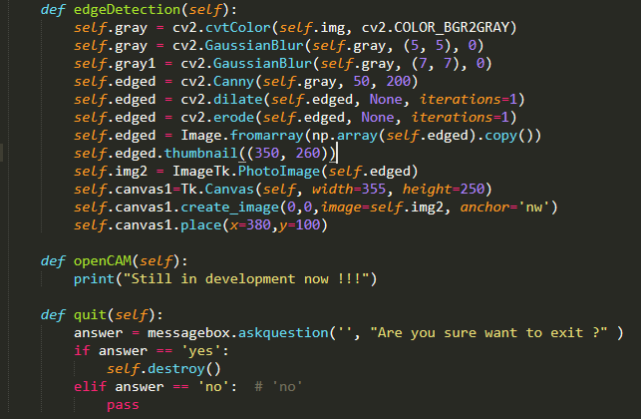
Code From Main Page Class
Method for edge detection
Statement condition
https://pillow.readthedocs.io/en/3.1.x/reference/Image.html

Slide 17
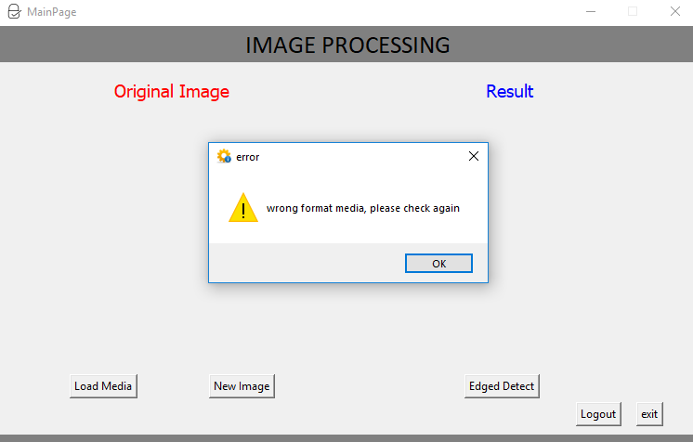
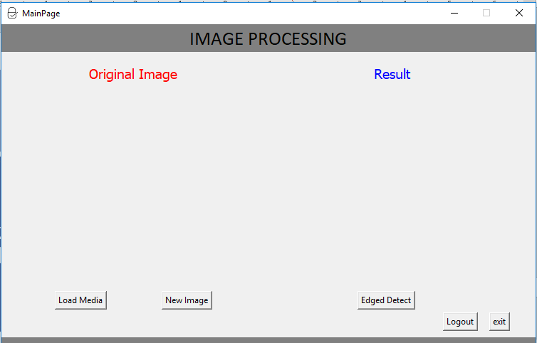
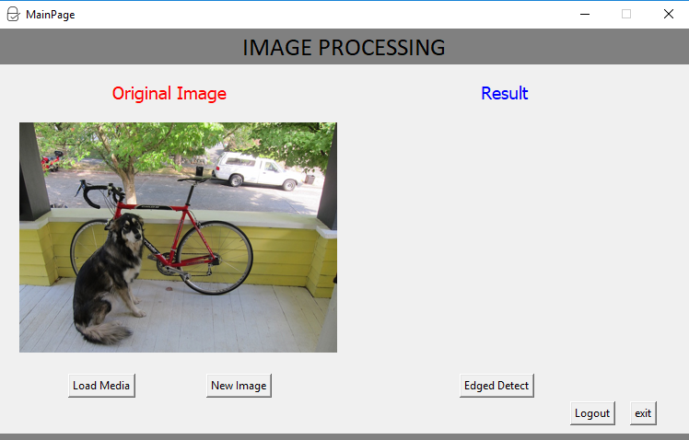
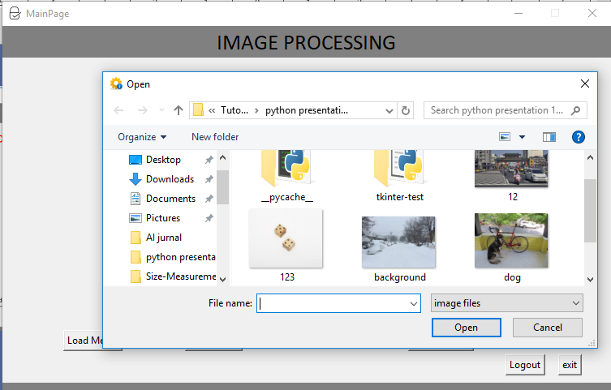
RESULT
Original Window Main page view
Message Error when wrong format file
File dialog open path view
Canvas create Choosing image

Slide 18
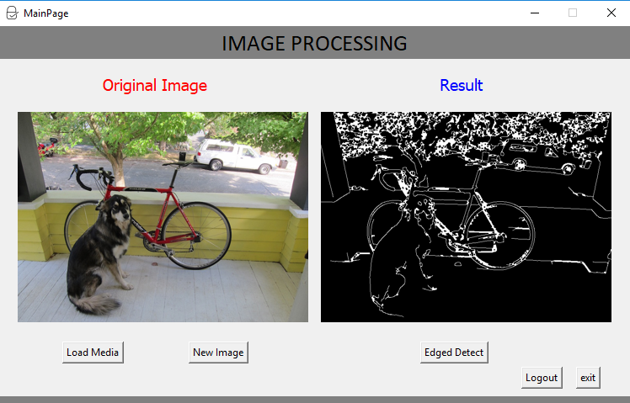
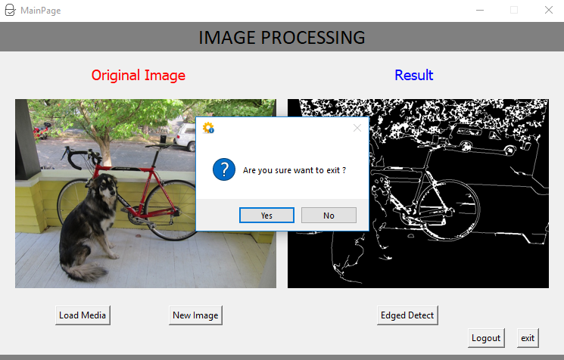
RESULT
The result edged detection object
Exit button

Slide 19
Any Question ????

Slide 20


